Slide 1
IMA Group 2
Ziming Guo ID: 2127468
Cheng Chen ID: 2119283
Yunpeng Lu ID: 2014873
Jiahao Shang ID: 2087608
Xinan Li ID: 2090506
Rongyu Wu ID: 1762922
Ruixin Hu ID: 2135790
MOIZ MASHADI MASHADI ID: 2149912

Slide 2
Division of IMA
Connecting to two APIs for collecting data and restored in data frame and CSV formats (Yunpeng+JIAHAO+XINAN)
Upload to MongoDB as a new database "Table" (RUIXIN + RONGYU + MOIZ)
Use CSV files to make data visualised by Tableau (ZIMING+ CHENG)

Slide 3

IMA Flowchart
MongoDB
Dict
APIs
Connecting APIs to collect data
Pandas
CSV
Github
https://github.com/Lynn-Luyp/wmg-ebm-bdtv-Group2
Data visualization by Tableau

Slide 4
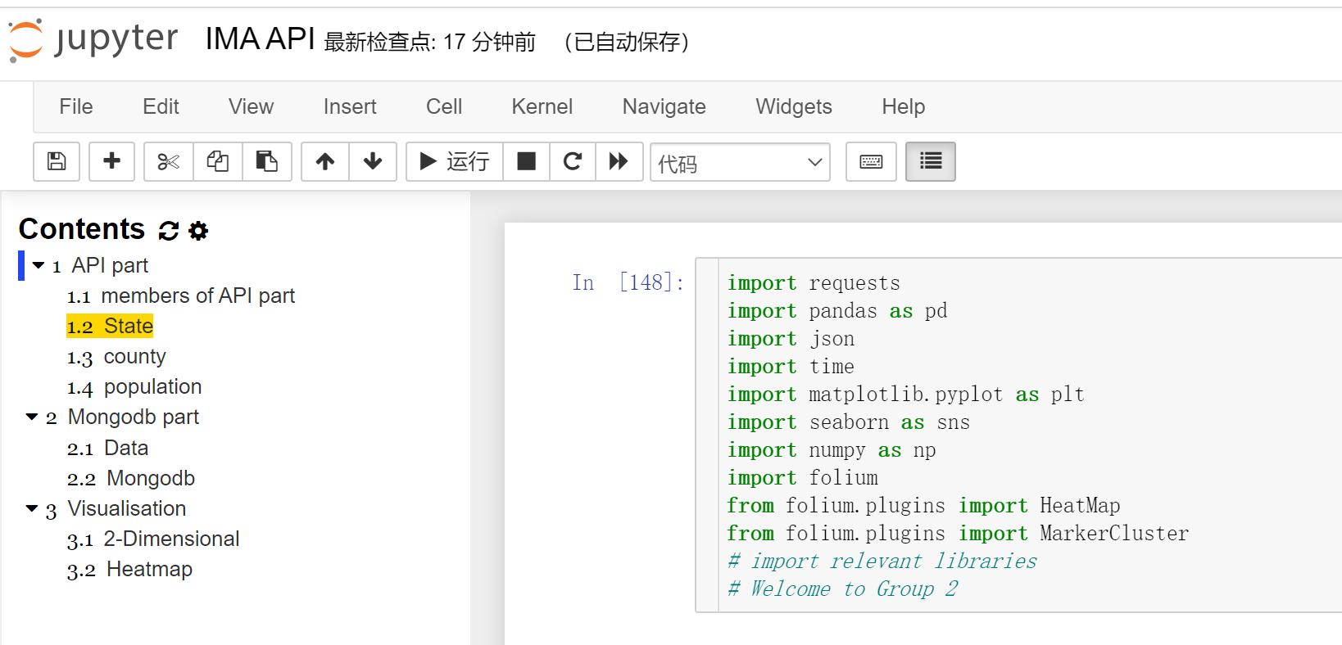

Slide 5
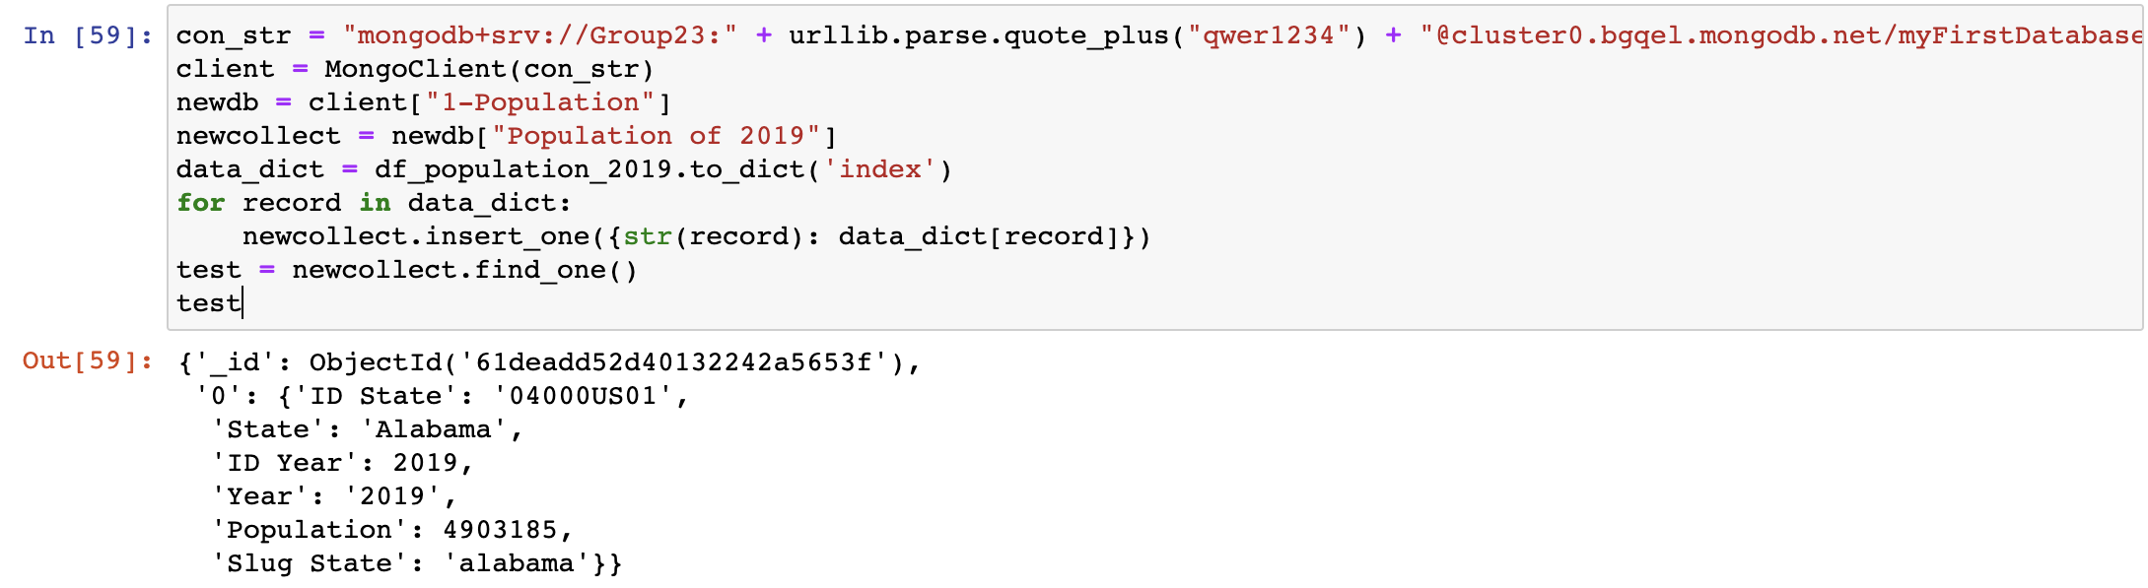
Transformation Part: Exhibition of code

Slide 6
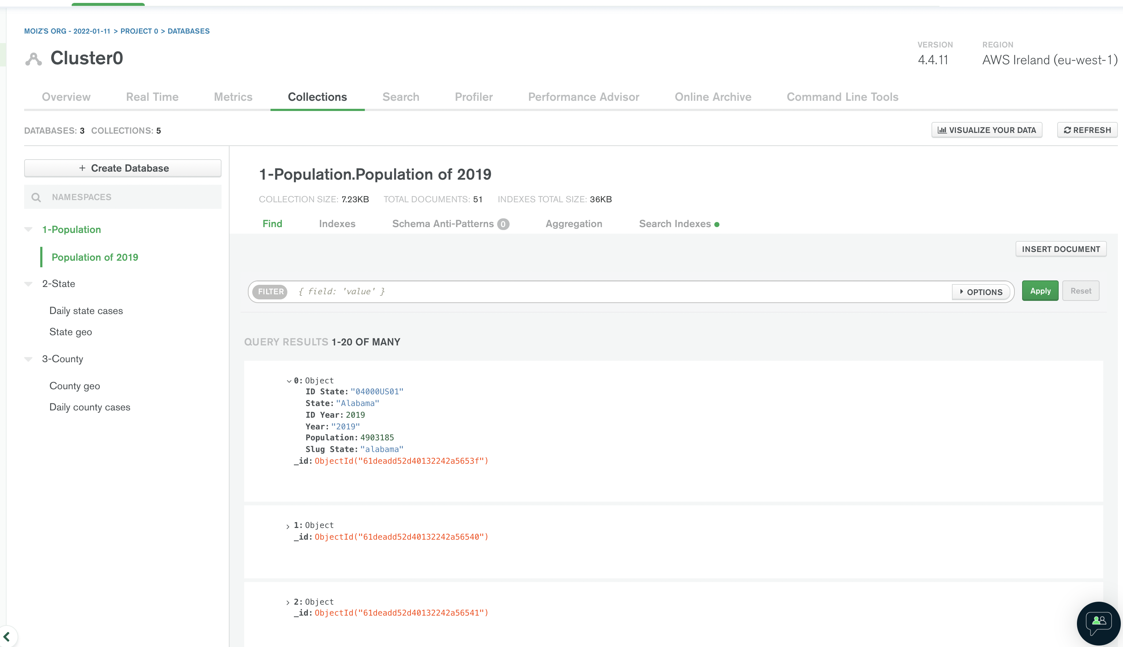
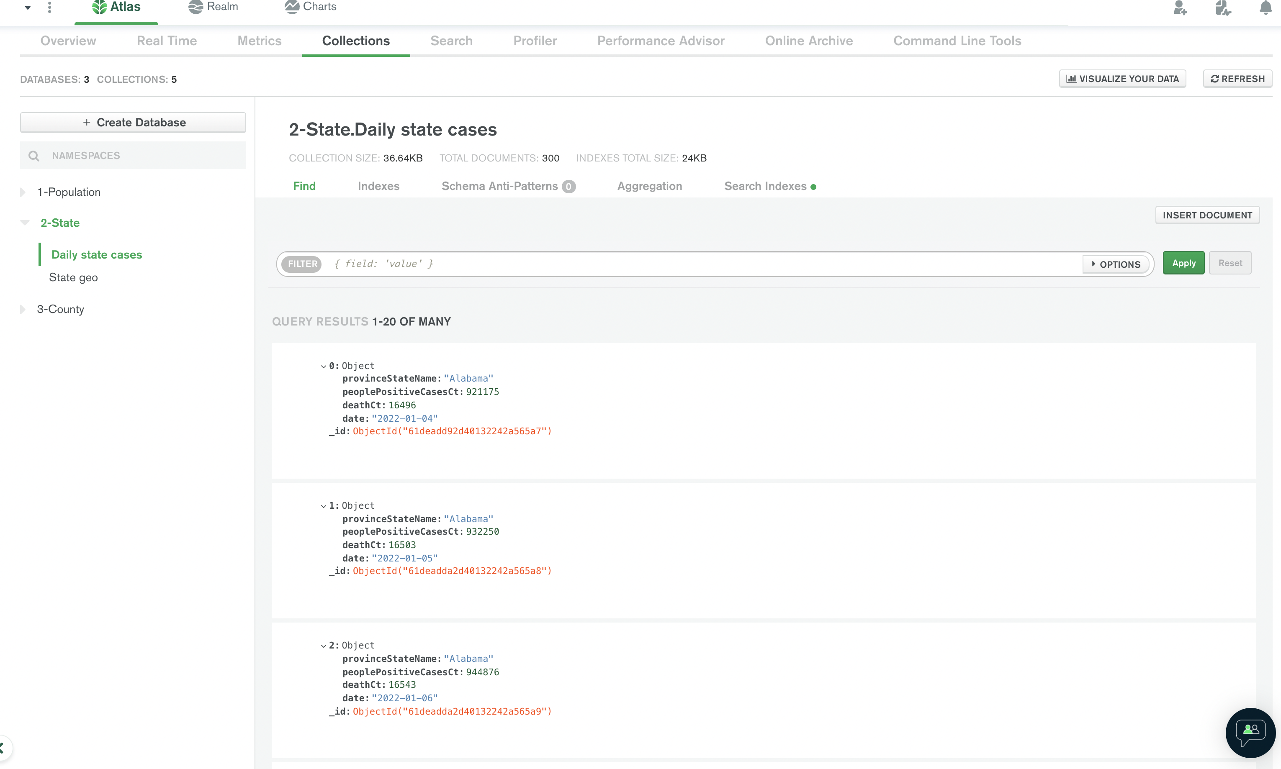
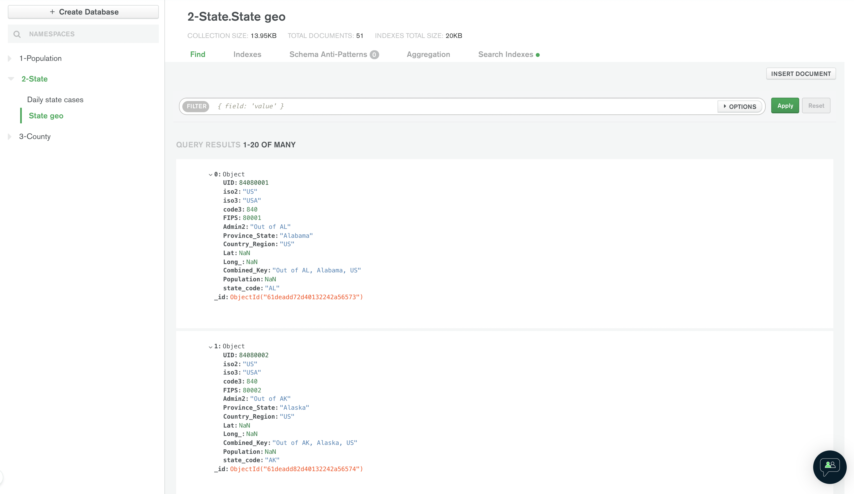
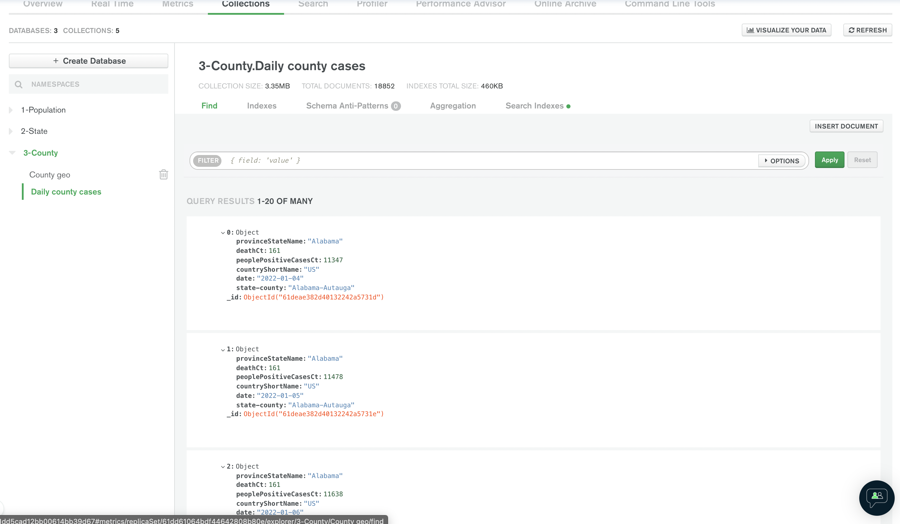

Slide 7
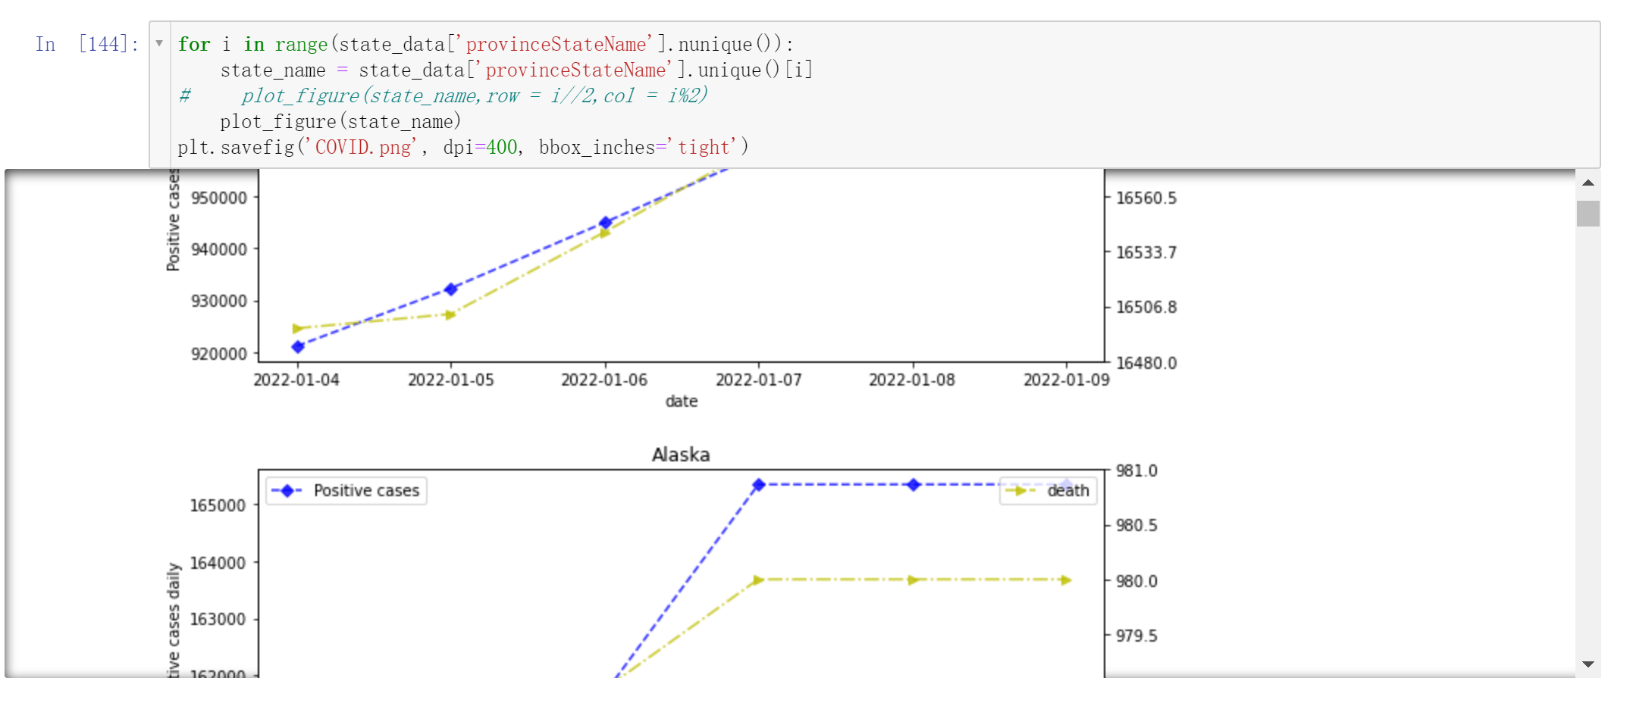

Slide 8
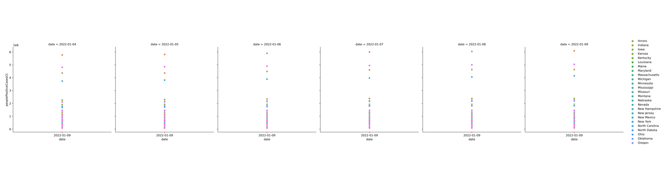
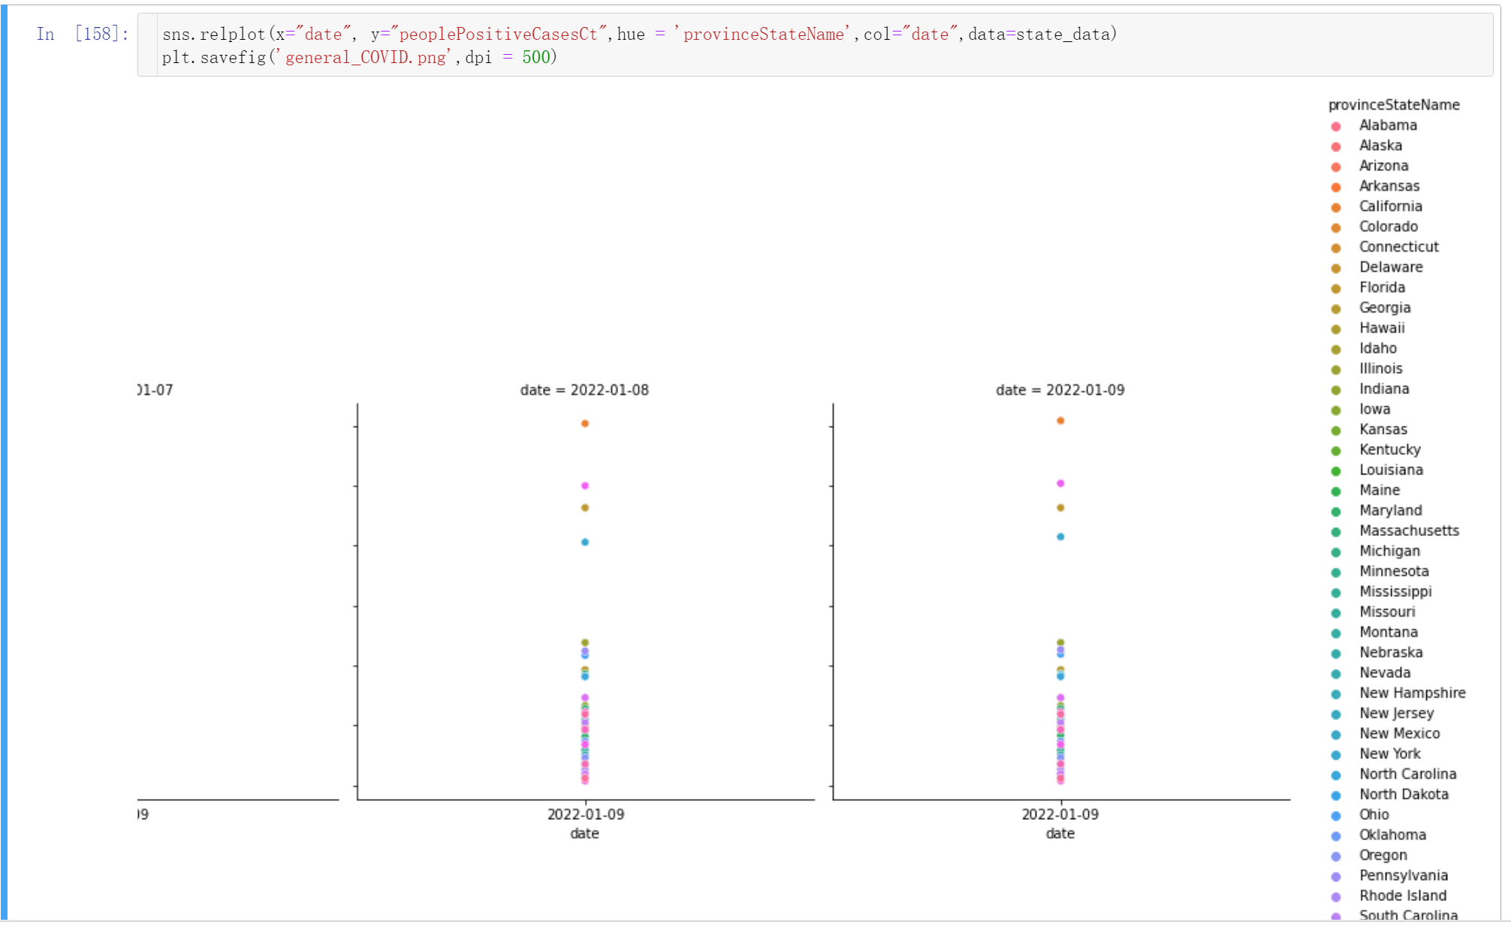

Slide 9
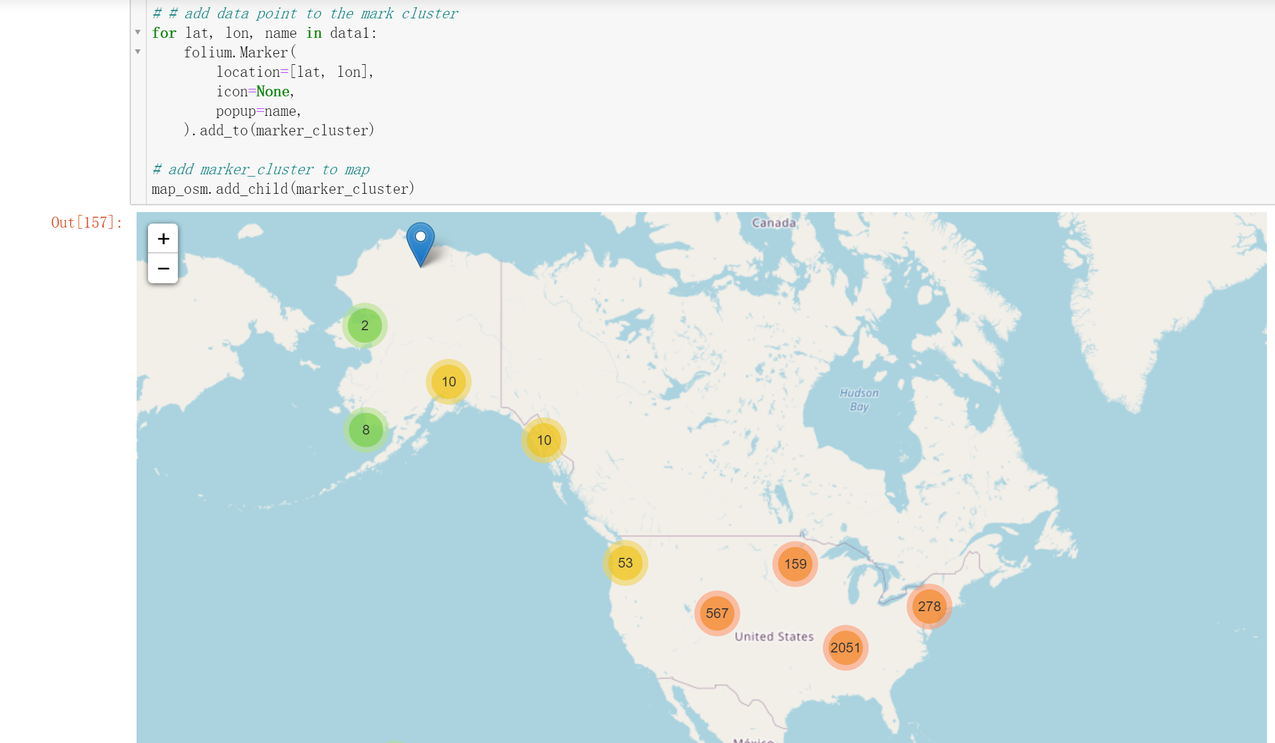

Slide 10
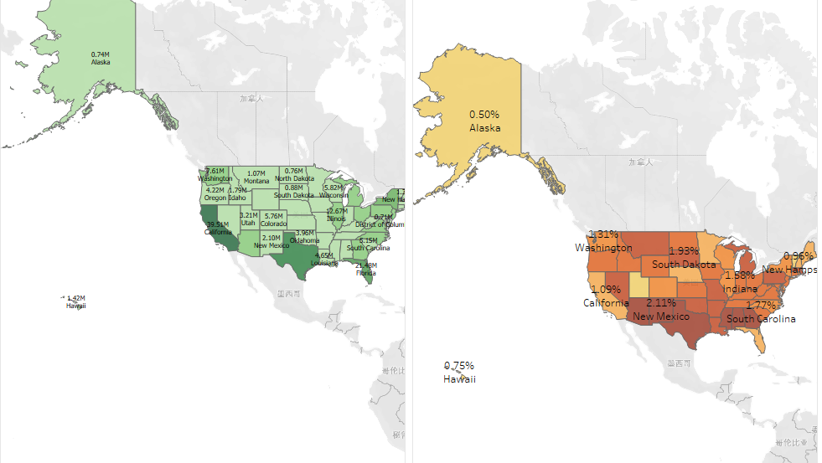
Data Visualization by Tableau

